Slide 1
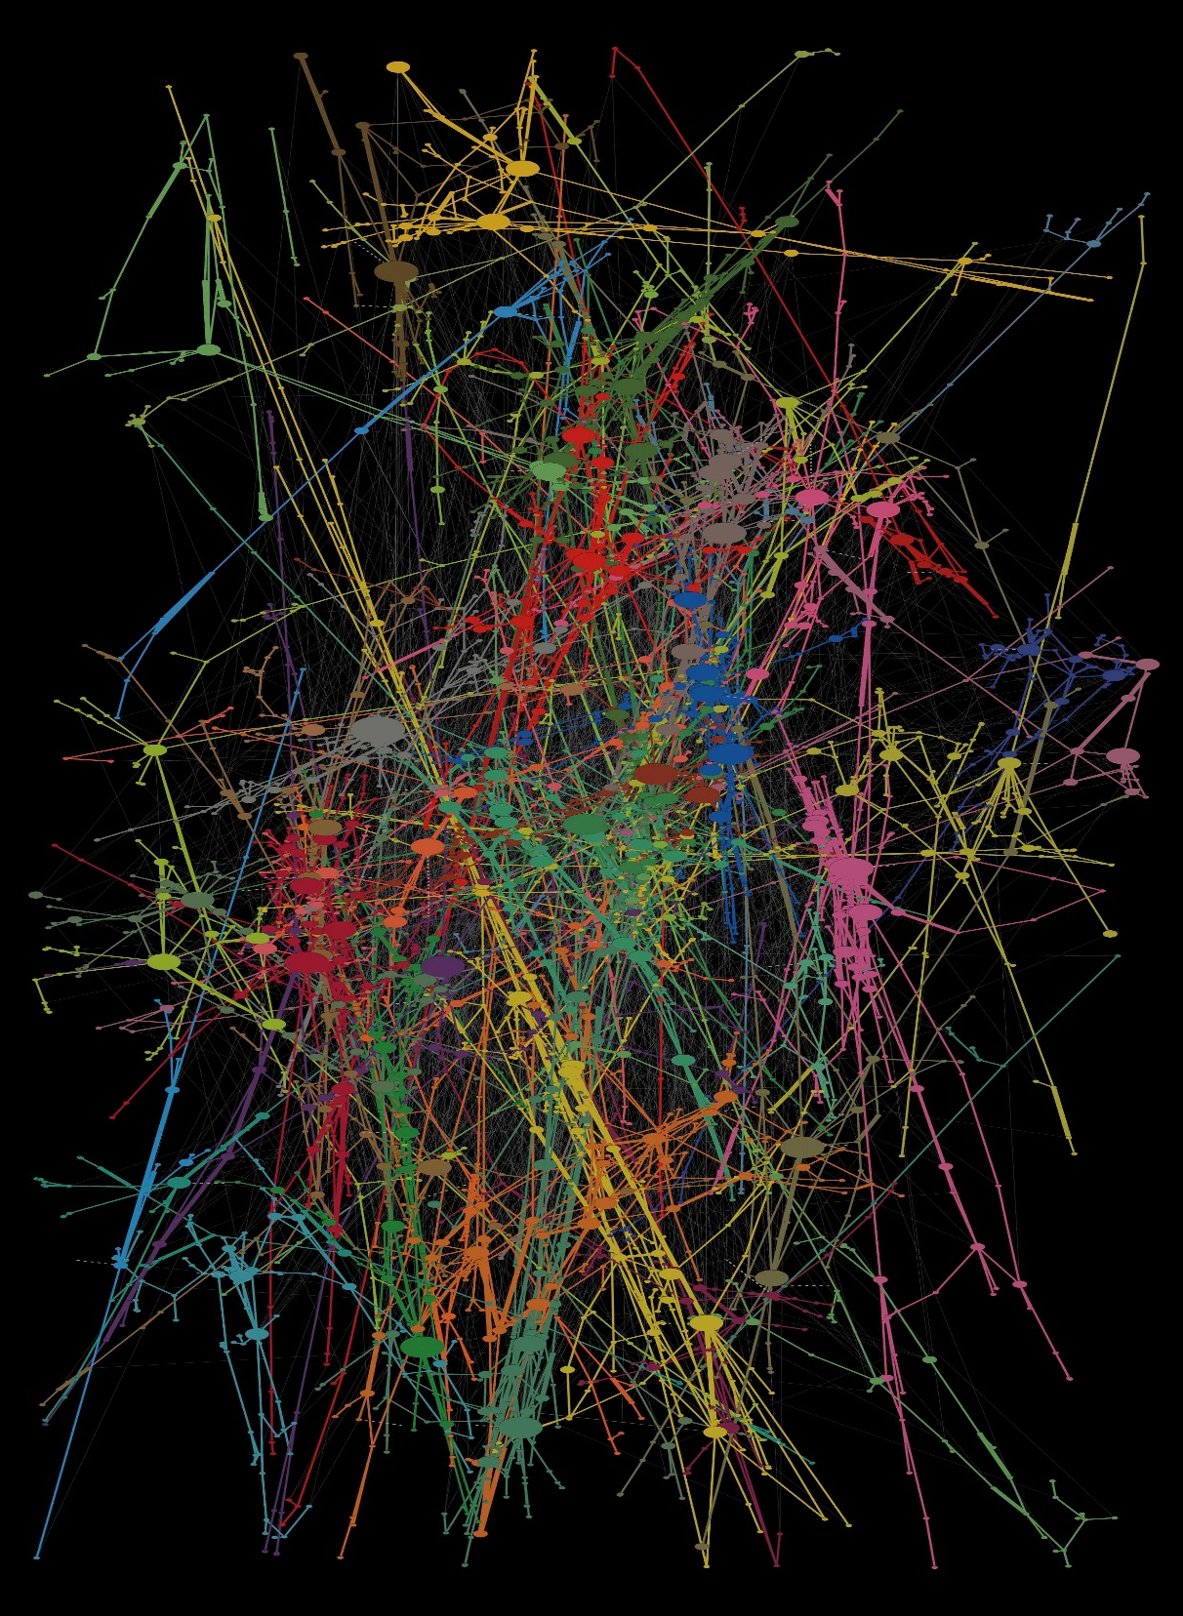

Peter
A Network of painters
Data engineering I. – Term 2
Alina Kurmantayeva
Gréta Zsikla
Mihály Hanics
Péter Török
06 December 2024

Slide 2
Agenda
Peter
1. Executive Summary
2. KNIME Workflow
3. Neo4j Operation
4. Analytics Results
Summary of project scope, data source and aim of the analyses
Overview of the KNIME workflow implementation
Outlining the network analytics carried out in Neo4j and KNIME
Overview of key analytics results and network visualization

Slide 3
Agenda
Peter
1. Executive Summary
2. KNIME Workflow
3. Neo4j Operation
4. Analytics Results
Summary of project scope, data source and aim of the analyses
Overview of the KNIME workflow implementation
Outlining the network analytics carried out in Neo4j and KNIME
Overview of key analytics results and network visualization

Slide 4
Our project work utilized 2 databased, an API and NoSQL solutions to analyse the network of painters in depth
Peter
PainterPalette dataset
Database containing the details of more than 10,000 painters
Extensive data cleaning
Clean to combine the datasets' artist lists effectively
API Calling
Utilizing the Wikipedia API to enrich data with artist details
Save processed data
Data joining
Improved join, and filtered exhibitions for the joined artists
Neo4j operations
Network analysis with applying Neo4j functionalities
Load processed data
E-flux announcements scraped data(set)
Online portal for announing various art exhibitions worldwide
Extensive data cleaning
Clean to combine the datasets' artist lists effectively
KNIME Server (ETL Implementation)
Partial outputs

Slide 5
Agenda
Peter
1. Executive Summary
2. KNIME Workflow
3. Neo4j Operation
4. Analytics Results
Summary of project scope, data source and aim of the analyses
Overview of the KNIME workflow implementation
Outlining the network analytics carried out in Neo4j and KNIME
Overview of key analytics results and network visualization

Slide 6
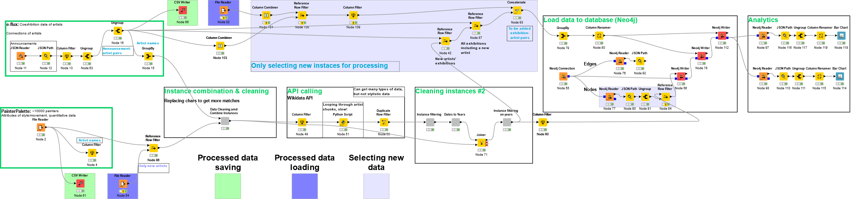
Our project work relies on a complex KNIME workflow that reads, cleans, aggregates and analyses data
Peter
Data processing layer
Data cleaning
API Calling
Data cleaning #2
Load to Neo4j DB
Analytics

Slide 7
Each layer of the KNIME workflow has a clearly defined function, intricately interconnected to efficiency
Gréti
Function | Reading and processing of the PainterPalette and eflux announcements containing artists and exhibitions | Extensive cleaning and standardization of names to implement the joining of the databases more effectively, resulting more matches | Application of API calls to enrich data with further details of artists (e.g., date and place of birth, citizenship etc.) | Connecting the KNIME workflow with Neo4j: load data into database, create and analyze network of artists
Output | Two databases with non-standardized record names and missing values | Joint database of exhibitions and standardized name artists. From 1012 to 1152 matches | Joint database with matching names and enriched data | Analytical insights and visualization of the network
Methods | File reader GroupBy JSON reader Column filter | GroupBy String manipulation | SparQL querying Python script (knio.Table) Retries on failures | Neo4j reader Neo4j connector
Data reading & import
Data cleaning & join
API implementation
Neo4j & Analytics

Slide 8
Each layer of the KNIME workflow has a clearly defined function, intricately interconnected to efficiency
Misi
Function | Application of API calls to enrich data with further details of artists (e.g., date and place of birth, citizenship etc.)
Output | Joint database with matching names and enriched data
Methods | SparQL querying Python script (knio.Table) Retries on failures
API implementation
SELECT ?person ?personLabel ?placeOfBirthLabel ?dateOfBirth...
WHERE { VALUES ?personLabel { {people_string} }
?person ?label ?personLabel.
?person wdt:P31 wd:Q5.
?person wdt:P19 ?placeOfBirth.
?person wdt:P569 ?dateOfBirth.
...
SERVICE wikibase:label { bd:serviceParam wikibase:language "en". } }
SparQL: Properties, values (identifiers), string labels
Query first paralel, retry missing instances, then retry for all languages
Transform result list of dicts into Pandas dataframe, then KNIME IO table

Slide 9
Each layer of the KNIME workflow has a clearly defined function, intricately interconnected to efficiency
Misi
Function | Reading and processing of the PainterPalette and eflux announcements containing artists and exhibitions | Extensive cleaning and standardization of names to implement the joining of the databases more effectively, resulting more matches | Application of API calls to enrich data with further details of artists (e.g., date and place of birth, citizenship etc.) | Connecting the KNIME workflow with Neo4j: load data into database, create and analyze network of artists
Output | Two databases with non-standardized record names and missing values | Joint database of artists and the recent exhibitions with standardized names | Joint database with matching names and enriched data | Analytical insights and visualization of the network
Methods | File reader GroupBy JSON reader Column filter | GroupBy String manipulation | SparQL querying Python script (knio.Table) Retries on failures | KNIME Neo4j extension Neo4j Connector Neo4j Writer, Reader
Data reading & import
Data cleaning & join
API implementation
Neo4j & Analytics

Slide 10
The KNIME workflow only processes new information and thus it fulfills ETL criterias
Misi
Old Exhibition-artist pairs (B)
Diff Exhibition-artist pairs (B)
Exhibition-artist pairs (B)
Artists (B)
New artist exhibitions
All new coexhibition
Artists (A)
Diff Artists (A)
Matched artists
Neo4j Updates
Old Artists (A)
- Partial outputs

Slide 11
Agenda
Misi
1. Executive Summary
2. KNIME Workflow
3. Neo4j Operation
4. Analytics Results
Summary of project scope, data source and aim of the analyses
Overview of the KNIME workflow implementation
Outlining the network analytics carried out in Neo4j and KNIME
Overview of key analytics results and network visualization

Slide 12
Our Neo4j integration is running on a server and uses the standardized datasets as inputs to create a network graph
Misi
Neo4j connection (AuraDB)
Set up connection to a common instance on AuraDB (free).
2.
Add edges (Neo4j Writer)
Adding artist exhibitions as edges of the graph, creating connections between nodes
4.
Add nodes (Neo4j Writer)
Adding artist names as nodes of the graph. Two inputs used:
Neo4j connection node
Artist table
Graph querying (Reader)
Analysing the final graph and answering analytical questions
Neo4j connection node
Artist table
1.
3.

Slide 13
Agenda
Alina
1. Executive Summary
2. KNIME Workflow
3. Neo4j Operation
4. Analytics Results
Summary of project scope, data source and aim of the analyses
Overview of the KNIME workflow implementation
Outlining the network analytics carried out in Neo4j and KNIME
Overview of key analytics results and network visualization

Slide 14
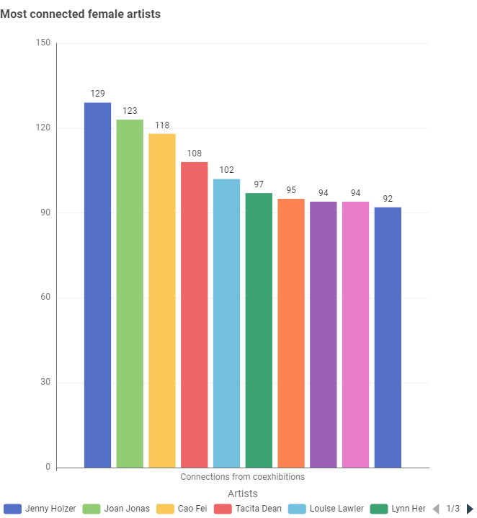
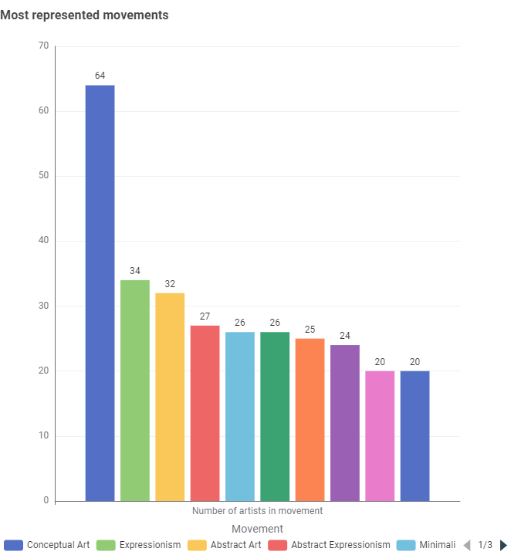
Our analysis included checking the network of female artists and most represented movements
Alina
Neo4j

Slide 15
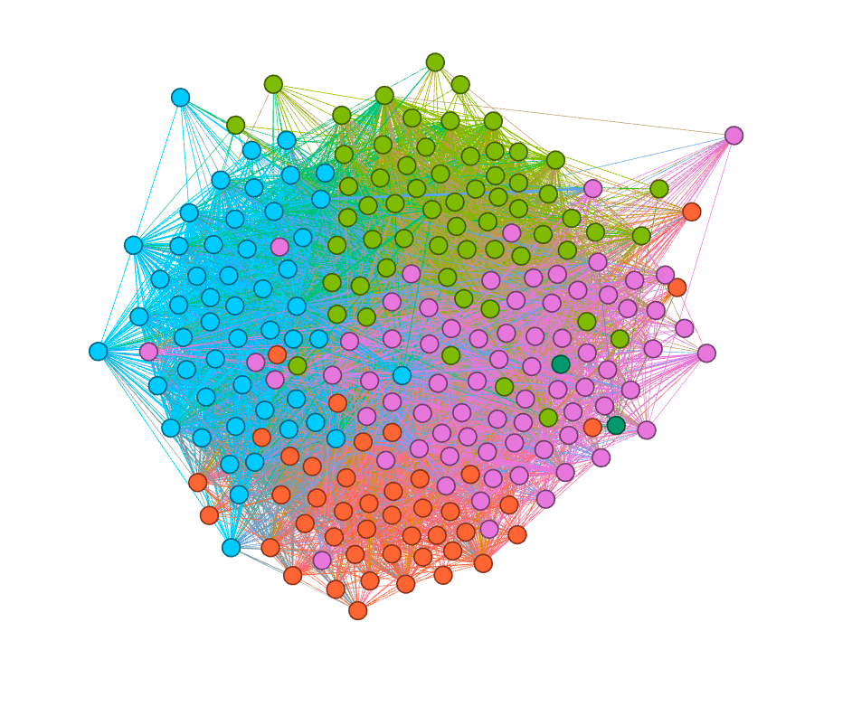
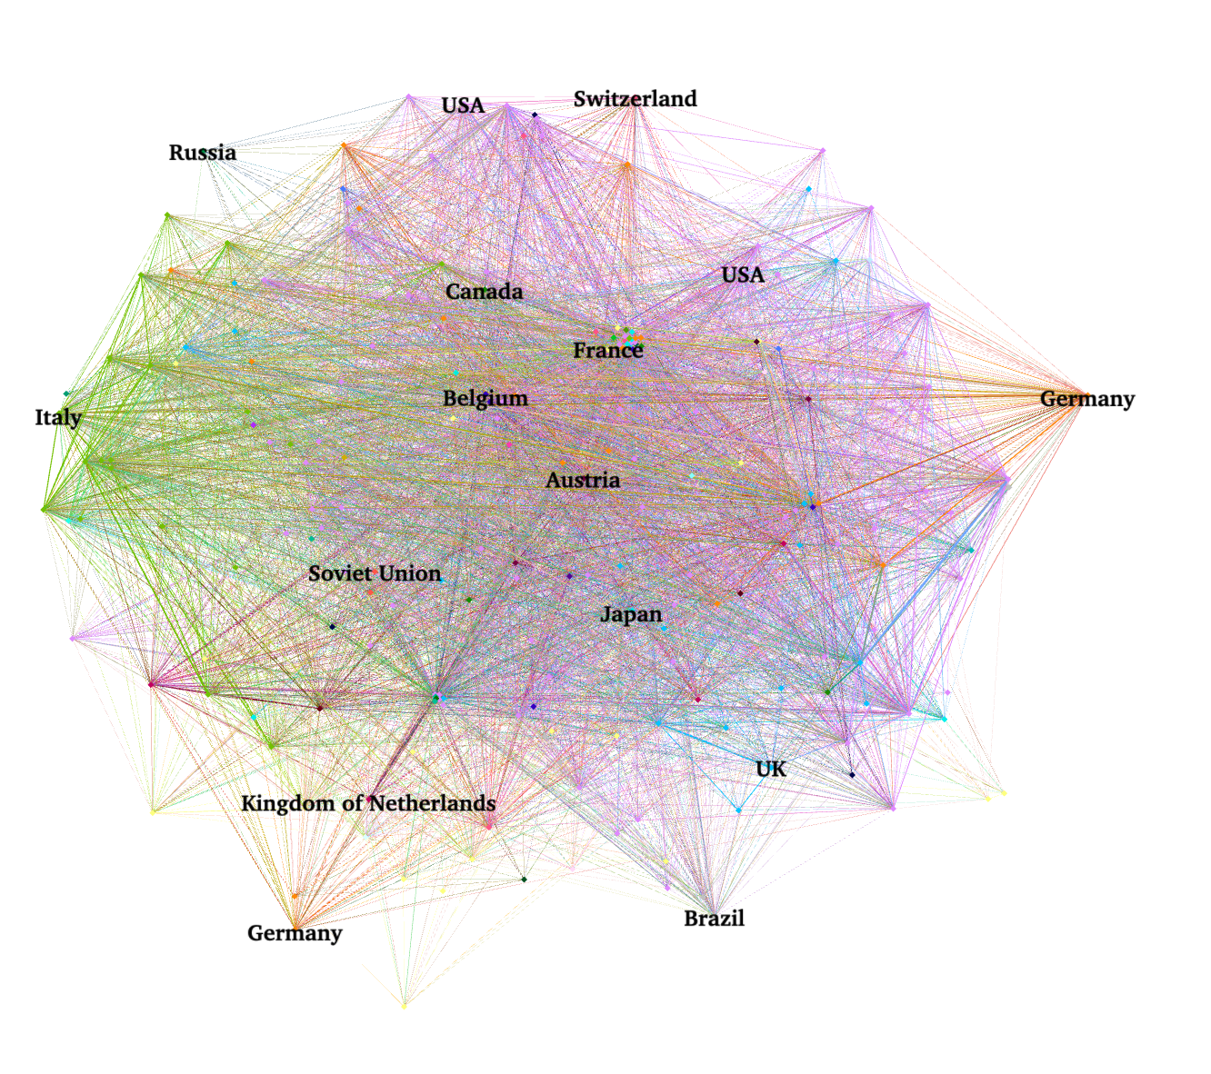
The network visualization in Gephi shows the major communities and networks of artists in a wholistic way
Alina
GEPHI
Network visualization of artists based on modularity clustering
Network visualization of artists based on citizenship centrality

Slide 16
Thank you for your attention!
Alina

Slide 17
Q&A

Slide 18
raw.githubusercontent.com/me9hanics/DataEngineering-SQL/refs/heads/main/Term2/imgs/workflow/workflow.svg

Slide 19
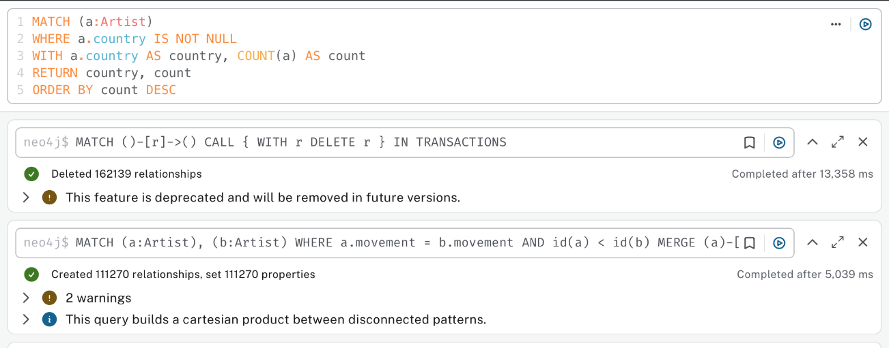
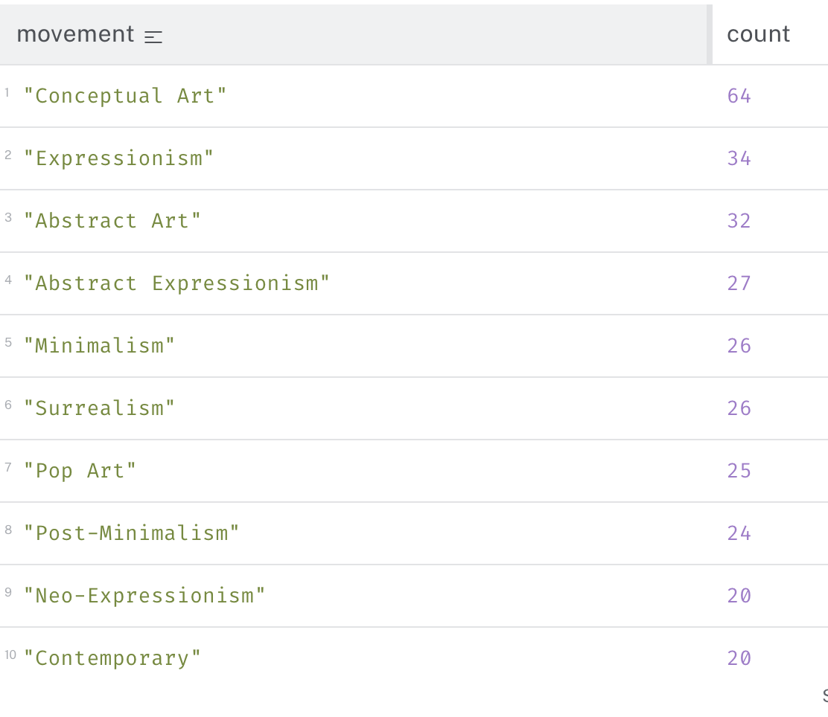
The deployment of Neo4j enabled us to visualize and analyse different dimensions of the network of artists
OVERALL ANALYTICS
Andy Warhol, Liam Gillick and Hito Steyerl are the most frequently exhibited artists in the dataset, accounting more than 750 exhibitions together
Most artists died in New York, while most have been born in Europe, indicating that the creative environment is more secure overseas
Conceptual Art, Expressionism and Abstract Art create the most connections between artist, while 20% hardly accounts any connections

Slide 20
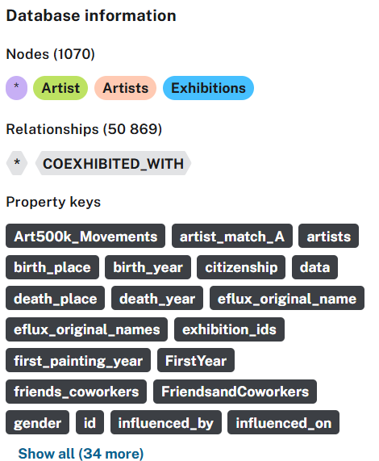
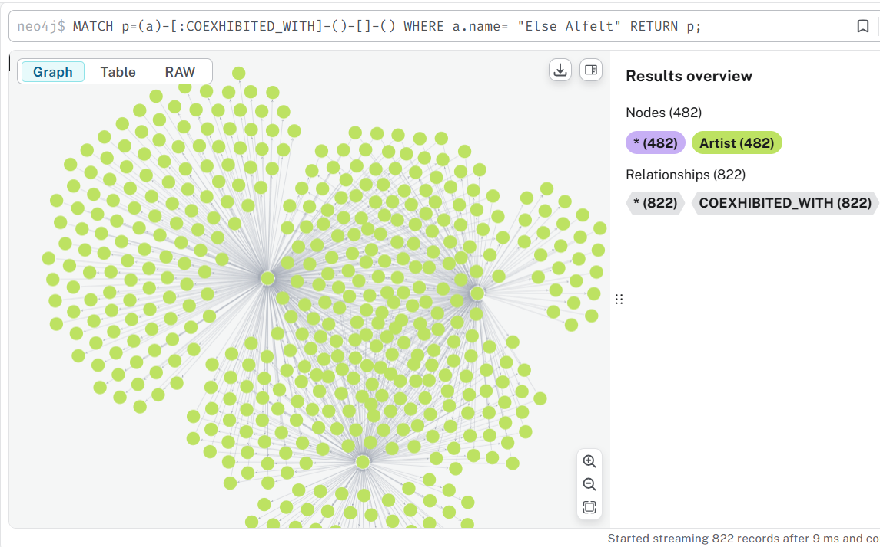

Slide 21
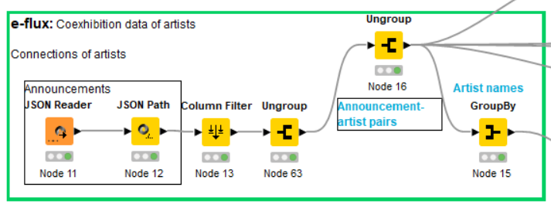
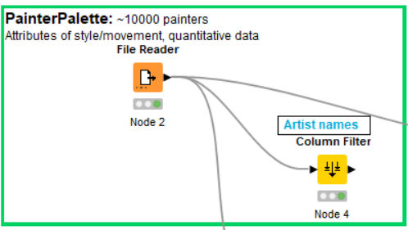

Slide 22
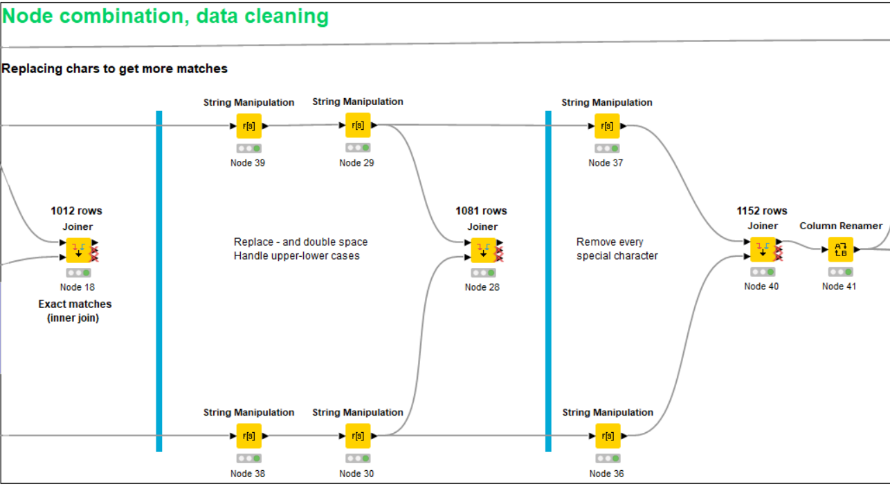

Slide 23
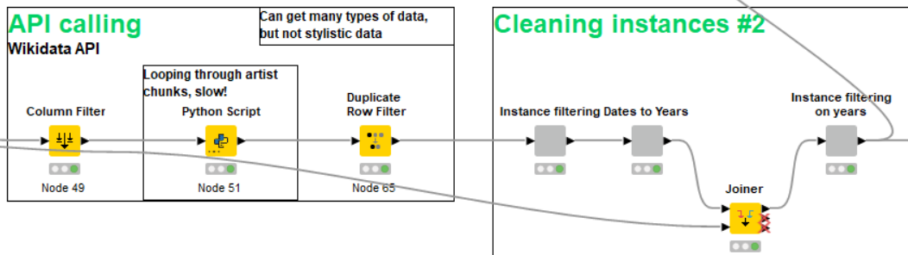

Slide 24
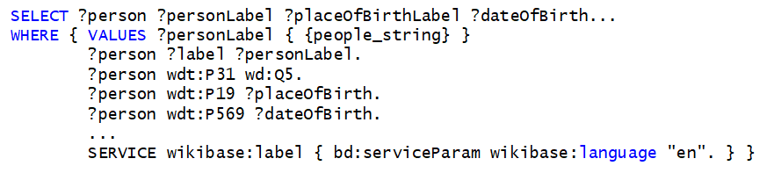
SparQL: Properties, values (identifiers), string labels
Query first paralel, retry missing instances, then retry for all languages
Transform result list of dicts into Pandas dataframe, then KNIME IO table
import knime.scripting.io as knio
data = list(knio.input_tables[0].to_pandas()['name’])
results_dict = query_multiple_people_retry_missing(data)
results_table = pd.DataFrame.from_dict(results_dict)
knio.output_tables[0] = knio.Table.from_pandas(results_table)

Slide 25
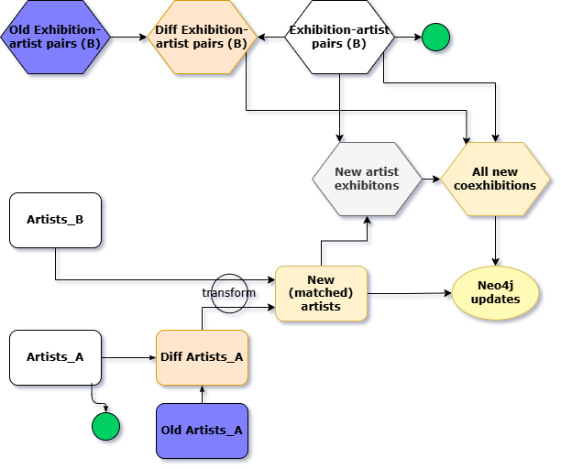

Slide 26
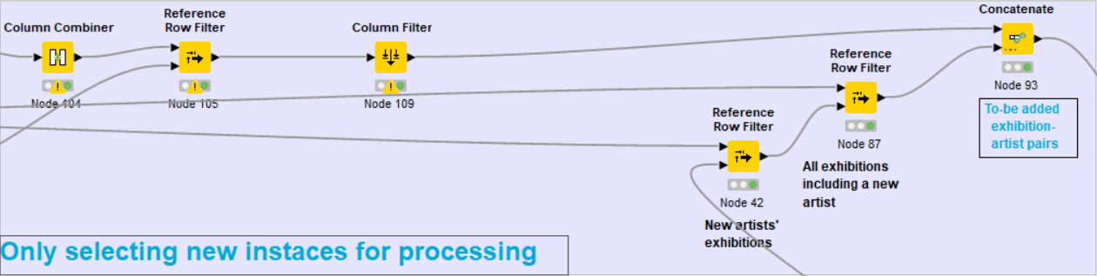
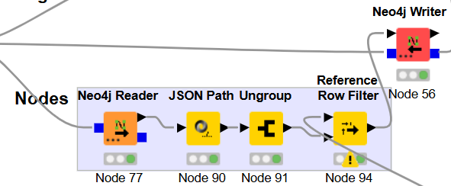

Slide 27
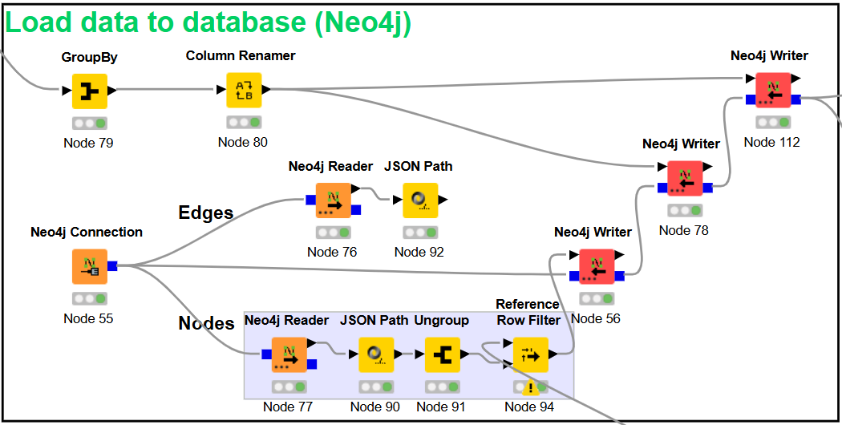

Slide 28
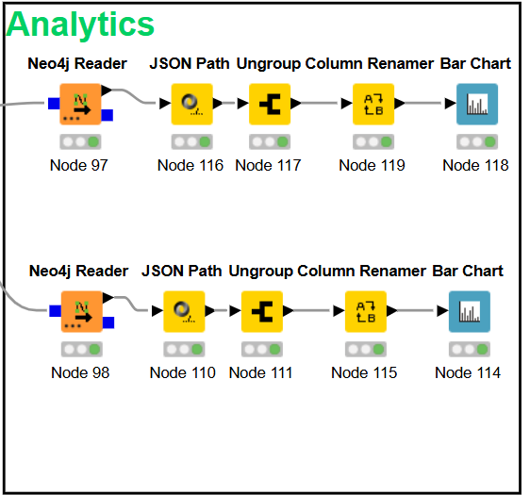

Slide 29
